Slide 1
Reading Pitch

Slide 2
What is this called?
What is it for?

Slide 3
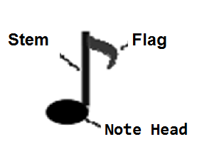
The note head is the part that shows pitch on the staff.
The rest of the note (stem, flag, or beam) show the duration (length) for rhythm.

Slide 4
The point of the staff is to show:
Notes can be HIGH
Notes can be LOW

Slide 5
The staff gives a specific high and low when notes are placed:
On LINES
Or between lines in SPACES

Slide 6
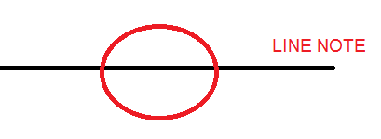

Slide 7
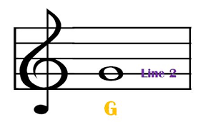
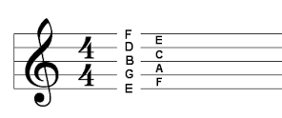

Slide 8
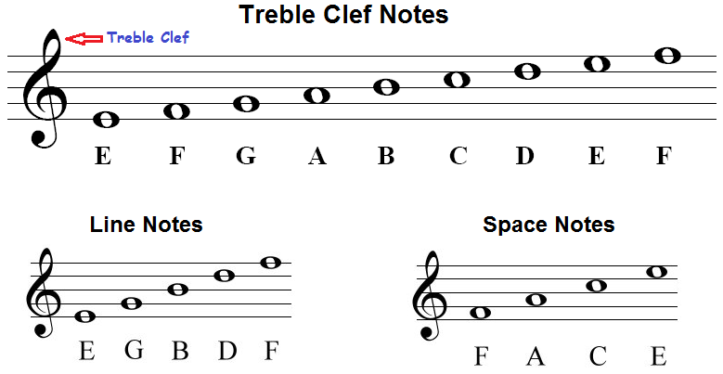

Slide 9
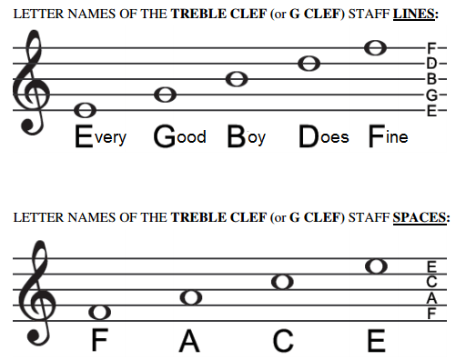

Slide 10
SPACE NOTES: FACE IN THE SPACE

Slide 11
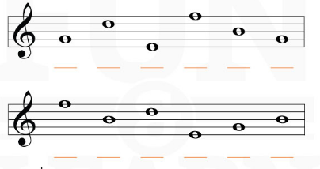
Line notes: Every Good Boy Does Fine

Slide 12
