Slide 2
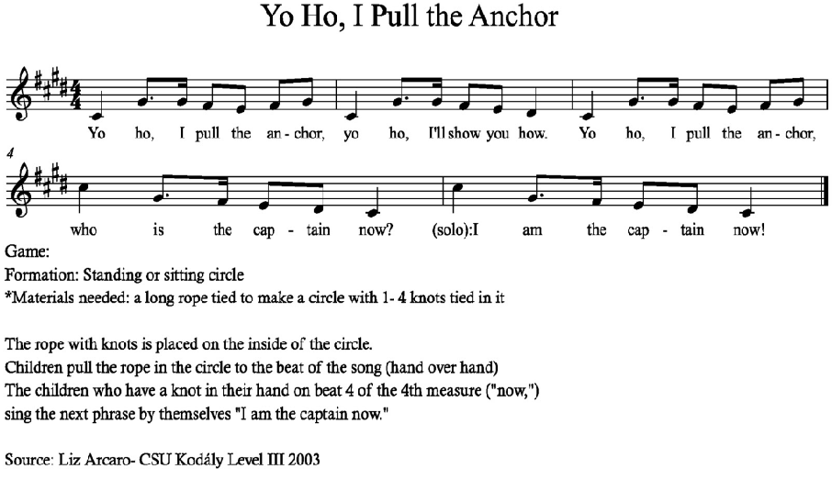

Slide 3
THE GHOST SHIP by Don Besig and Nancy Price
Now listen well as a X tale I tell of a night I shook with fear-------
We were sailing west on the X open sea, Headin’ home from a long--- long year.
I was standing watch all alone that night When I heard--- a wailing cry-----------
As I Strained to see what the X sound could be, Something flashed, and caught..my eye------------
And the cold wind blew….oo…oo…oo…oo (PART 1: l-t-d-t-l) (PART 2: l-s-f-s-l)
And the cold wind blew----------------------
‘Twas then I spied off the X starboard side------ a strange----mysterious sight-------
I froze with fear as it X drifted near like a ghost in the dark…of night----------
I could see a sail on a broken mast And deserted decks below-----------
From all around came a mournful sound, But I saw not a liv--ing soul!-----------------------
And the cold wind blew….oo…oo…oo…oo (as above – then key change!)
Part 2 : And the cold wind blew (higher pitch this time)------------------
Part 1: (ECHO) And the cold wind blew (also the new higher pitch) NEW KEY – UP A STEP
Well I held fast to the X forward mast as the Ship-----moved slowly on.-----------
And I Watched that way ‘til the X break of day, When I knew that it fin’lly had gone----------------------
Oh, they laughed and joked as I told my tale to the Captain and the men.-------
But the story’s true, I can X promise you, and it’s Sure --- to happen again.------------ Yes, it’s sure -------------- to happen a---gain-------------
PART 1: And the cold wind blew….oo……..oo….…oo………oo
And the cold wind blew (la------ti-------do------re-------mi) (high) m-m s m s ( few on high d)
PART 2: And the cold wind blew….oo……..oo….…oo………oo
And the cold wind blew (la------so------fa------so-------la) (low) m-m s l d l

Slide 4
Heave Ho, Me Laddies!
Oh, if I were a pirate out a sailing on the sea,
I really am quite certain, a captain I would be
||: Heave Ho me laddies! Fasten down the sails.
This lusty wind will take us a sailing o’er the sea : ||

Slide 5
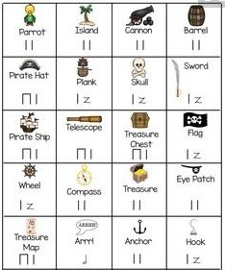
Pirate Composing

Slide 6
